Slide 1
Image Matching Challenge
Team 14
110550067簡秉霖, 110550165何存益, 111550020方漢霖, 110550085房天越

Slide 2
Outline
Introduction
Related Works
Proposed Approach
Experimental Results
Conclusions
Member Contribution Table
Code Link
References

Slide 3
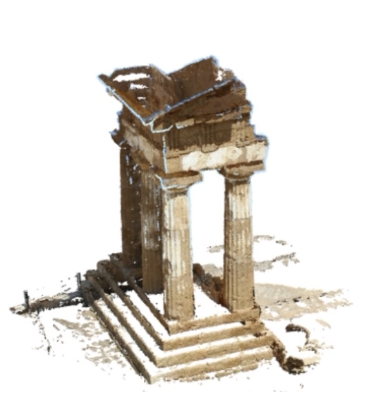
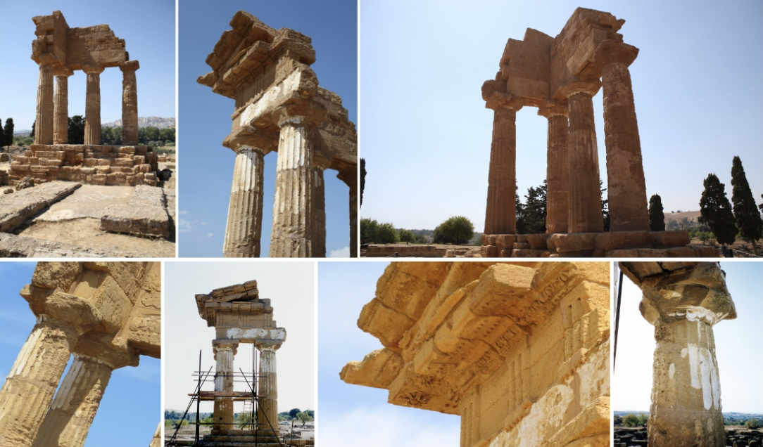
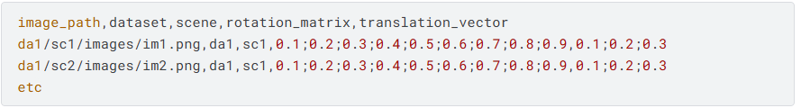
Introduction - Problem Statement
Our goal is to is to match 2-D images to reconstruct the 3-D structure of that scene and obtain the rotation and translation matrix.

Slide 4
Introduction - Importance
3D reconstruction from 2D images only requires standard RGB cameras.
After reconstruction, 3D models can generate novel 2D views of a scene or object for training data.
Useful for robot navigation, autonomous driving, augmented reality (AR), etc.

Slide 5
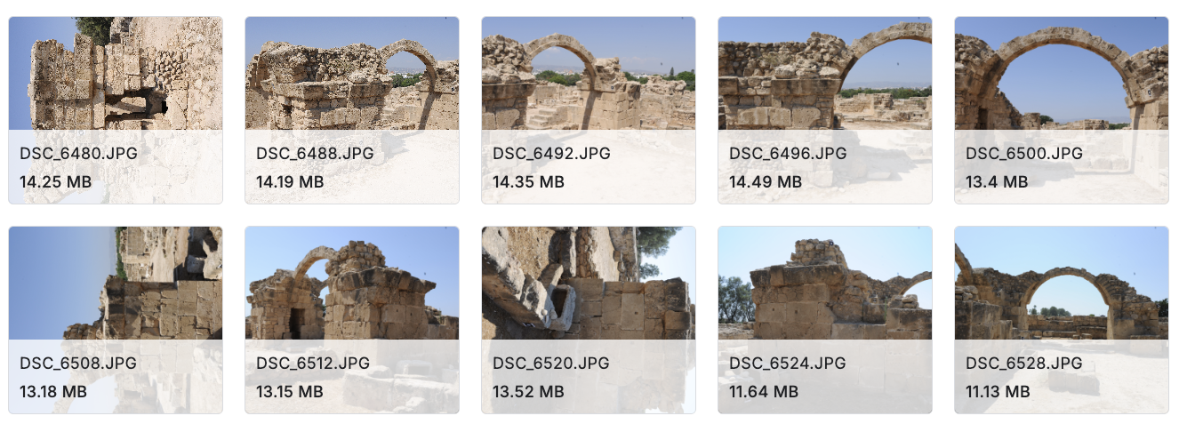
Introduction - Difficulties Encountered
Images with random rotation in specific scene.
Occluded or textureless regions are difficult to match.
Close to 9 hours of notebook scoring time for each submission. In addition, due to limited runtime in the notebook environment, we must carefully deal with computational cost.
heritage/cyprus

Slide 6
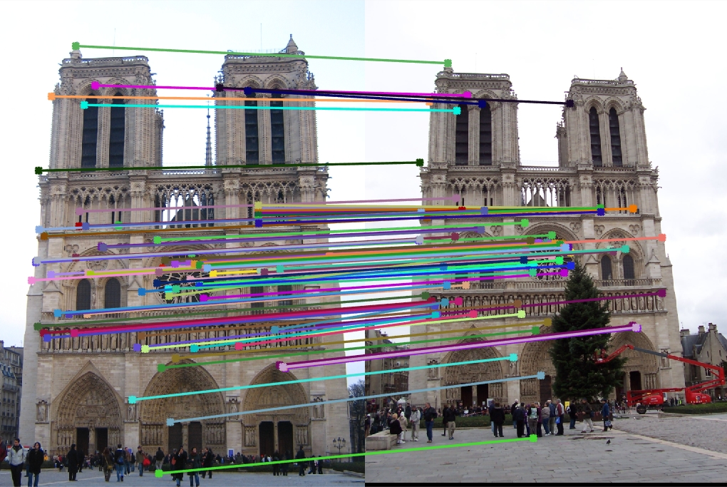
Related Works - Components
Keypoint detecting
[5] SuperPoint
[9] SIFT
[10] KeyNet
[11] ALIKED
[12] DISK
Feature matching
[6] SuperGlue
[13] LoFTR
3D reconstruction
[14] COLMAP

Slide 7
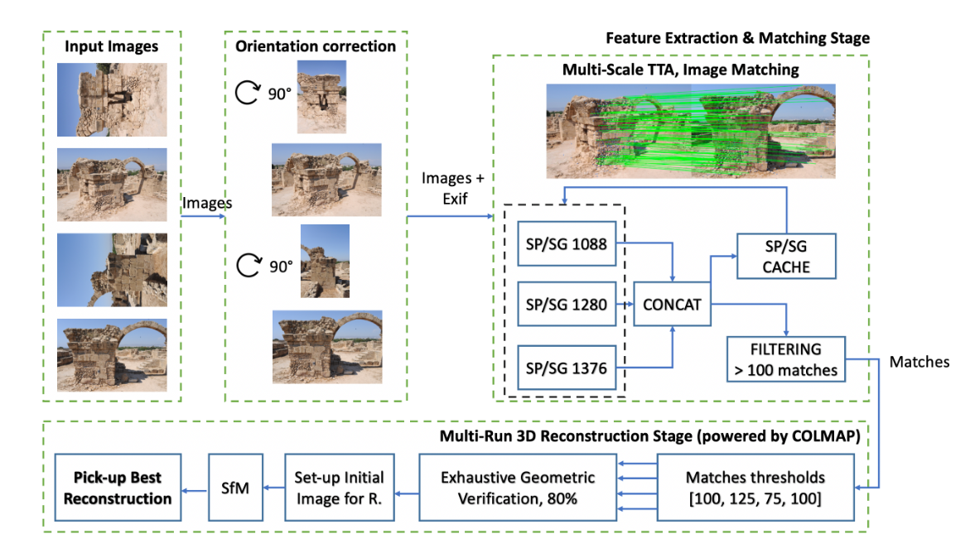
Related Works - 2nd Place Proposal

Slide 8
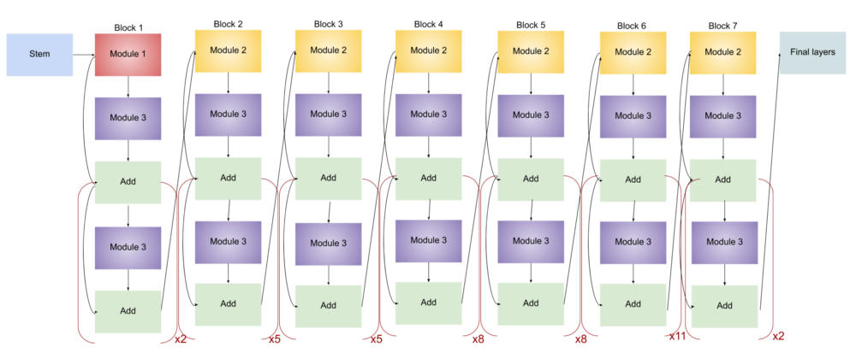
Related Works
EfficientNet B7
Pretrained on ImageNet1K.
A highly efficient Convolutional Neural Network (CNN) for image tasks.
Generate global descriptors of input images which are used to pair up images within the same scene.

Slide 9
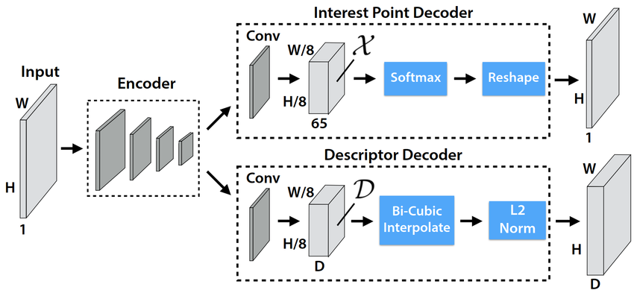
Related Works
SuperPoint
Pretrained on MS-COCO.
A self-supervised deep learning model that efficiently detects robust keypoints and their descriptors in images.
Output detected keypoints of input images as input of the following matching model.

Slide 10
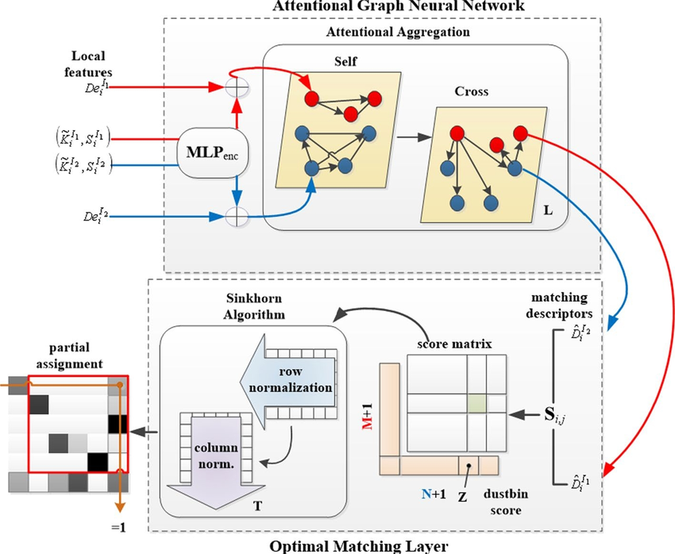
Related Works
SuperGlue
Pretrained on MegaDepth(outdoor weight).
A deep learning model that matches sets of local features (keypoints and descriptors) between two images. Takes the outputs from a feature detector as input.

Slide 11
Related Works
1. 2nd Place Team
Used SuperPoint + SuperGlue at three image scales (1088, 1280, 1376) and concatenated matches (TTA ensemble) to boost robustness.
Mitigated COLMAP randomness by running match_exhaustive 10× and keeping only matches appearing ≥ 8/10 times; for scenes < 45 images, executed full SfM multiple times with varying match thresholds, selecting the best result.
Added rotate-detection to correct 90°/270° images and manual image initialization (pick seed image with highest match count), yielding final Public 0.506/Private 0.562 (2nd place).

Slide 12
Related Works
3. 7th Team
Replaced SuperGlue with LightGlue (LG) and experimented with DISK, ALIKE-D, SIFT (long edge = 1600). Used NetVLAD (k = 30) to retrieve top-K pairs instead of exhaustive pairing.
Built ensembles combining (ALIKE-D + LG), (DISK + LG), (SIFT + NN), then merged matches from all models; achieved LG-only Public 0.361/Private 0.407, and ALIKED2K + DISK + SIFT (LG+LG+NN) Public 0.475/Private 0.523.
Integrated PixSfM refinement (if no rotation) and forced shared camera intrinsics per scene in COLMAP; used hloc to localize unregistered images via existing camera poses or EXIF.

Slide 13
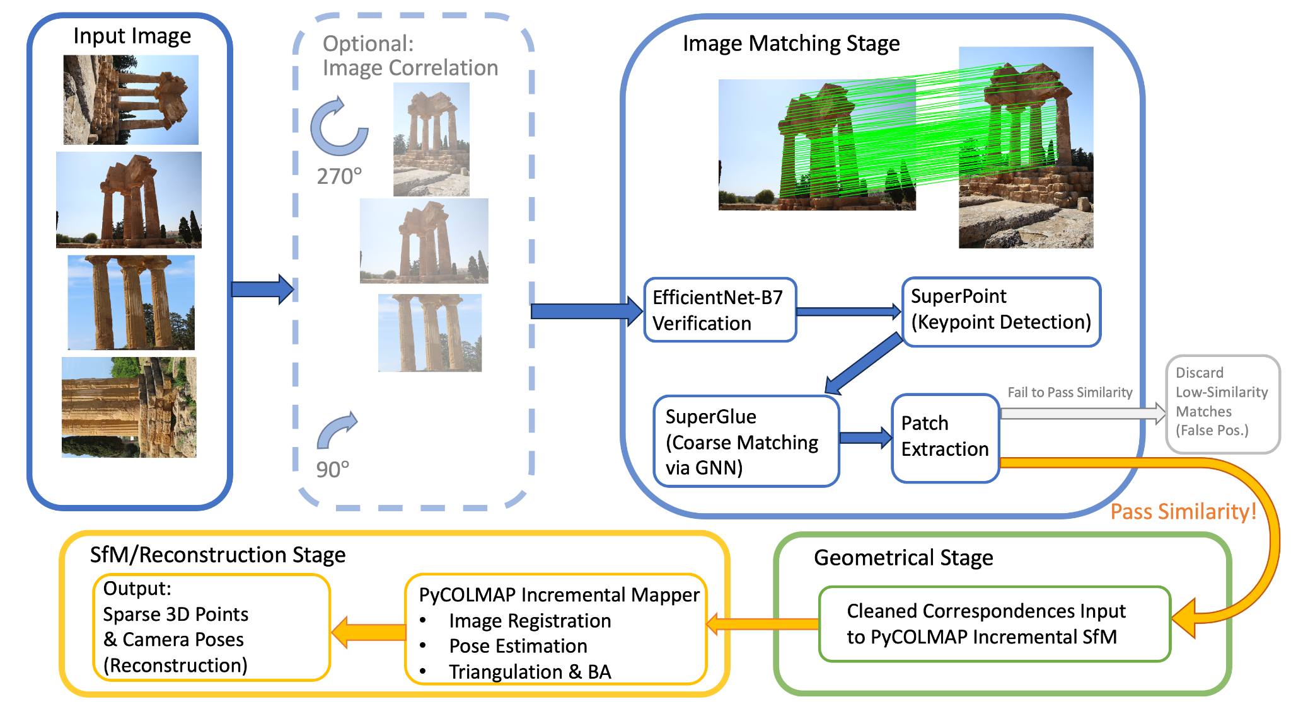
Proposed Approaches

Slide 14
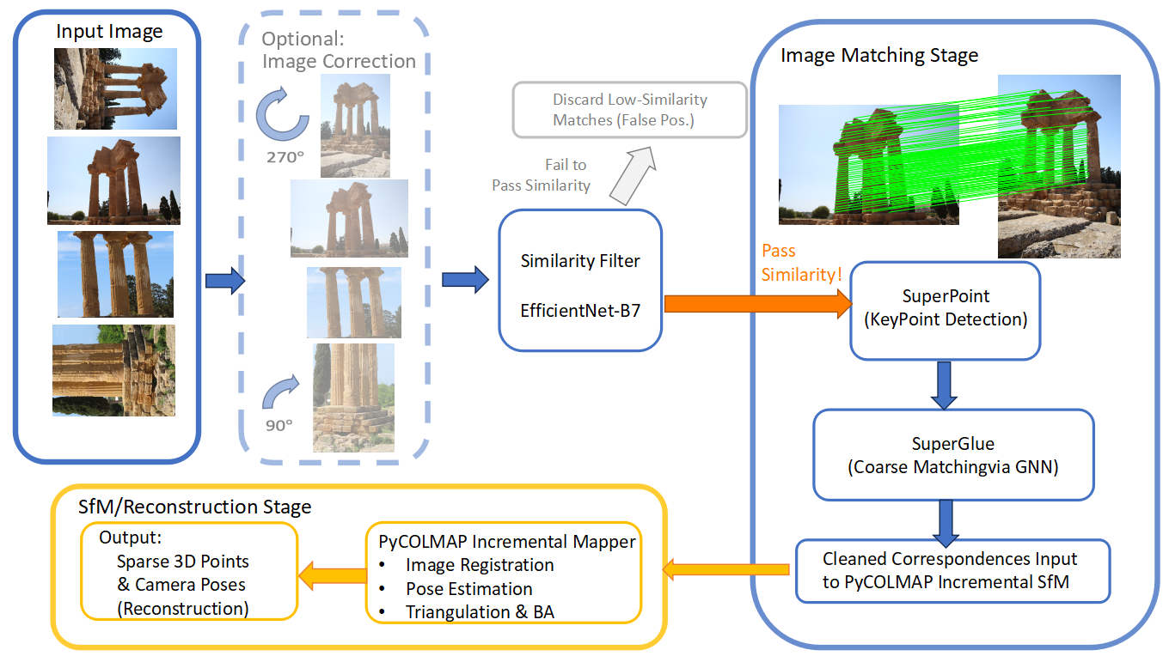
Proposed Approaches

Slide 15
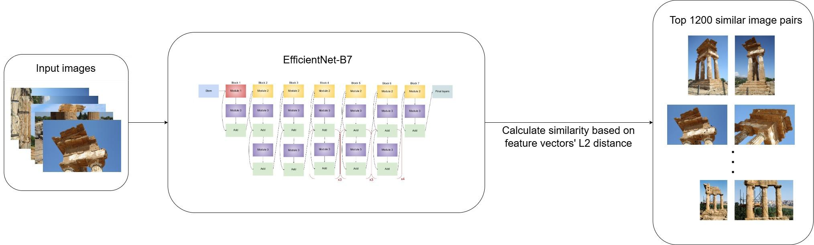
Stage1: Image Pair Generation
Use EfficientNet-B7 to extract top 1200 most similar image pairs

Slide 16
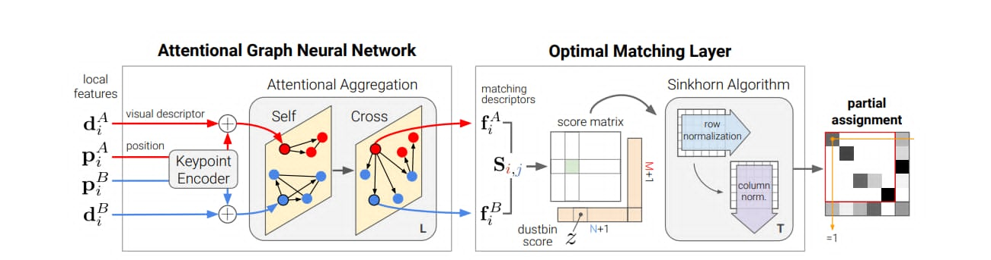
Stage2: Image Matching (1/2)
SuperPoint
Output :
Interest points – 2D coordinates of salient points
Descriptors – 256-dim feature vectors for each keypoint
SuperGlue
SuperGlue uses the interest points and descriptors to find correspondences.

Slide 17
Stage2: Image Matching (2/2)
Cleaned Correspondences
Remove duplicate : Merge repeated keypoints and discard repeated pairs.
Remap match indicies : Align match indicies to the unique keypoints.
Enforce one-to-one matches : Keep only unique one-to-one correspondences

Slide 18
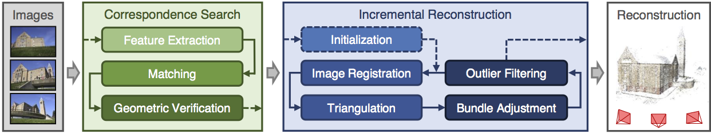
Stage3: 3D Structure from Motion
COLMAP
Input: images along with pre-computed keypoints and matches from SP/SG
Output: extrinsic parameters of each camera, including rotation and translation matrix
Keypoints
Matches
SP/SG
extract extrinsic parameters

Slide 19
Experimental Results - Dataset and Evaluation Metrics
Dataset
We evaluate on the IMC2023 test set, which expects to find roughly 1,100 images in the hidden test set. The number of images in a scene may vary from <10 to ~250.
Evaluation Metrics
Use mean Average Accuracy (mAA) to evaluate pose estimation.
For each image pair, we compute relative rotation and translation errors, evaluate accuracy over 10 thresholds (1°–10°, 0.2m–5m), and average the results across thresholds, scenes, and datasets.

Slide 20
Experimental Results - Leaderboard
Competition Rank | Private Score
1st | 0.570
2nd | 0.562
3rd | 0.534
ours | 0.531

Slide 21
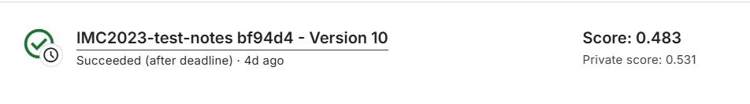
Experimental Results

Slide 22


Experimental Results - Ablation Study
Finetuning SuperPoint
Configuration | Private Score | Public Score
No Finetune | 0.495 | 0.444
Finetune with IMC 2023 | 0.512 | 0.478
Finetune with IMC 2025 | 0.531 | 0.483

Slide 23
Experimental Results - Ablation Study
Replacing SuperGlue with LightGlue
Configuration | Private Score | Public Score
Superpoint + Lightglue | 0.465 | 0.400
Superpoint + Superglue | 0.495 | 0.444
score dropped

Slide 24
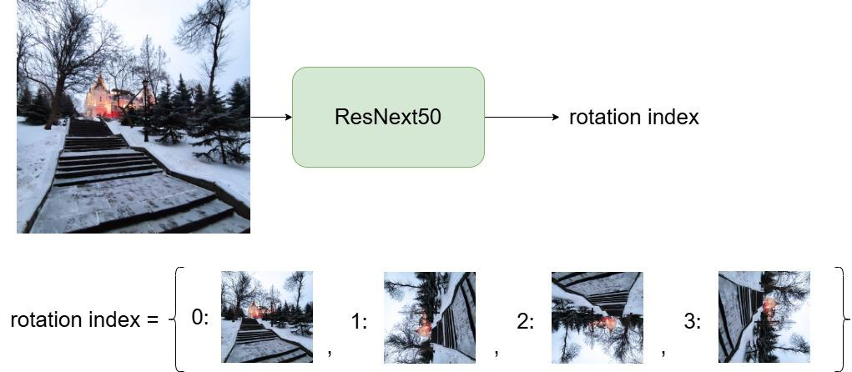
Experimental Results - Ablation Study
Orientation correction
Configuration | Private Score | Public Score
Keypoint threshold 0.005 + rotation | 0.307 | 0.258
Keypoint threshold 0.001 + rotation | 0.312 | 0.259
Keypoint threshold 0.001 | 0.531 | 0.483
abnormally low score when adding rotation!!

Slide 25
Conclusions
Task: predict camera pose parameterized by rotation matrix and translation matrix of pictures with different views.
Model architecture:
Image pairing -> EfficientNetB7
Keypoint detecting -> SuperPoint
Keypoint matching -> SuperGlue
SfM -> COLMAP
Performance:
Best run: 0.531

Slide 26
Member Contribution Table
 | 110550067 | 110550165 | 111550020 | 110550085
Literature Survey | 25 | 25 | 40 | 10
Approach Design | 25 | 25 | 40 | 10
Approach Implementation (Experiment) | 25 | 25 | 40 | 10
Report Writing | 20 | 20 | 40 | 20
Slides Making and Oral Presentation | 30 | 20 | 20 | 30

Slide 27
Code (GitHub Repo Link)
https://github.com/hjhjhjhhjhjhhh/Visual-Recognition-using-Deep-Learning-2025-Spring-Final-Project

Slide 28
References
[1] https://www.kaggle.com/competitions/image-matching-challenge-2023/discussion/416873
(2nd Place Work)
[2] https://www.kaggle.com/competitions/image-matching-challenge-2023/discussion/417045
(6th Place Work)
[3] https://github.com/veichta/IMC-2023 (7th Place Work)

Slide 29
References
[4] https://colmap.github.io/ (COLMAP)
[5] https://ieeexplore.ieee.org/document/7780814 (SuperPoint)
[6] https://arxiv.org/abs/1911.11763 (SuperGlue)
[7] https://github.com/ternaus/check_orientation (check_orientation)
[8]https://arxiv.org/abs/1905.11946 (EfficientNet)
[9]https://www.cs.ubc.ca/~lowe/papers/ijcv04.pdf (SIFT)
[10]https://arxiv.org/abs/1904.00889 (KeyNet)

Slide 30
References
[11]https://arxiv.org/abs/2304.03608 (ALIKED)
[12]https://arxiv.org/abs/2006.13566 (DISK)
[13]https://arxiv.org/abs/2104.00680 (LoFTR)
[14]https://github.com/colmap/colmap (COLMAP)

Slide 31
THANK YOU!

